Slide 1

7th Grade Math
Unit 12, Lesson 4 Volume of Right Circular Cylinders – Part 1 Volume 2, pg. 212

Slide 2


Benchmark
MA.7.GR.2.3
Solve mathematical and real-world problems involving volume of right circular cylinders.
volume 2, pg. 212

Slide 3
Integrated Mathematical Thinking and Reasoning Standards
MA.K12.MTR.1.1 Actively participate in effortful learning both individually and collectively.
MA.K12.MTR.4.1 Engage in discussions that reflect on the mathematical thinking of self and others.
MA.K12.MTR.5.1 Use patterns and structure to help understand and connect mathematical concepts.
MA.K12.MTR.7.1 Apply mathematics to real-world contexts.
volume 2, pg. 212

Slide 4

Learning Target
I can find the volume of a right circular cylinder.
volume 2, pg. 212

Slide 5

Warm-Up
volume 2, pg. 213

Slide 6
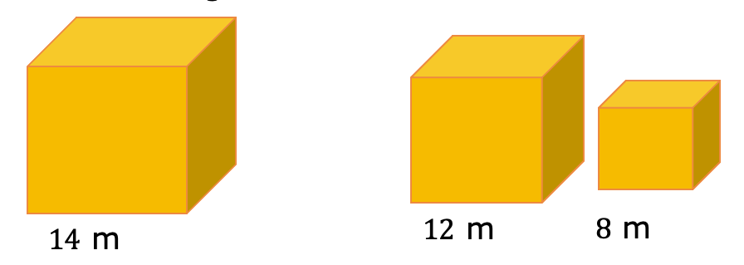
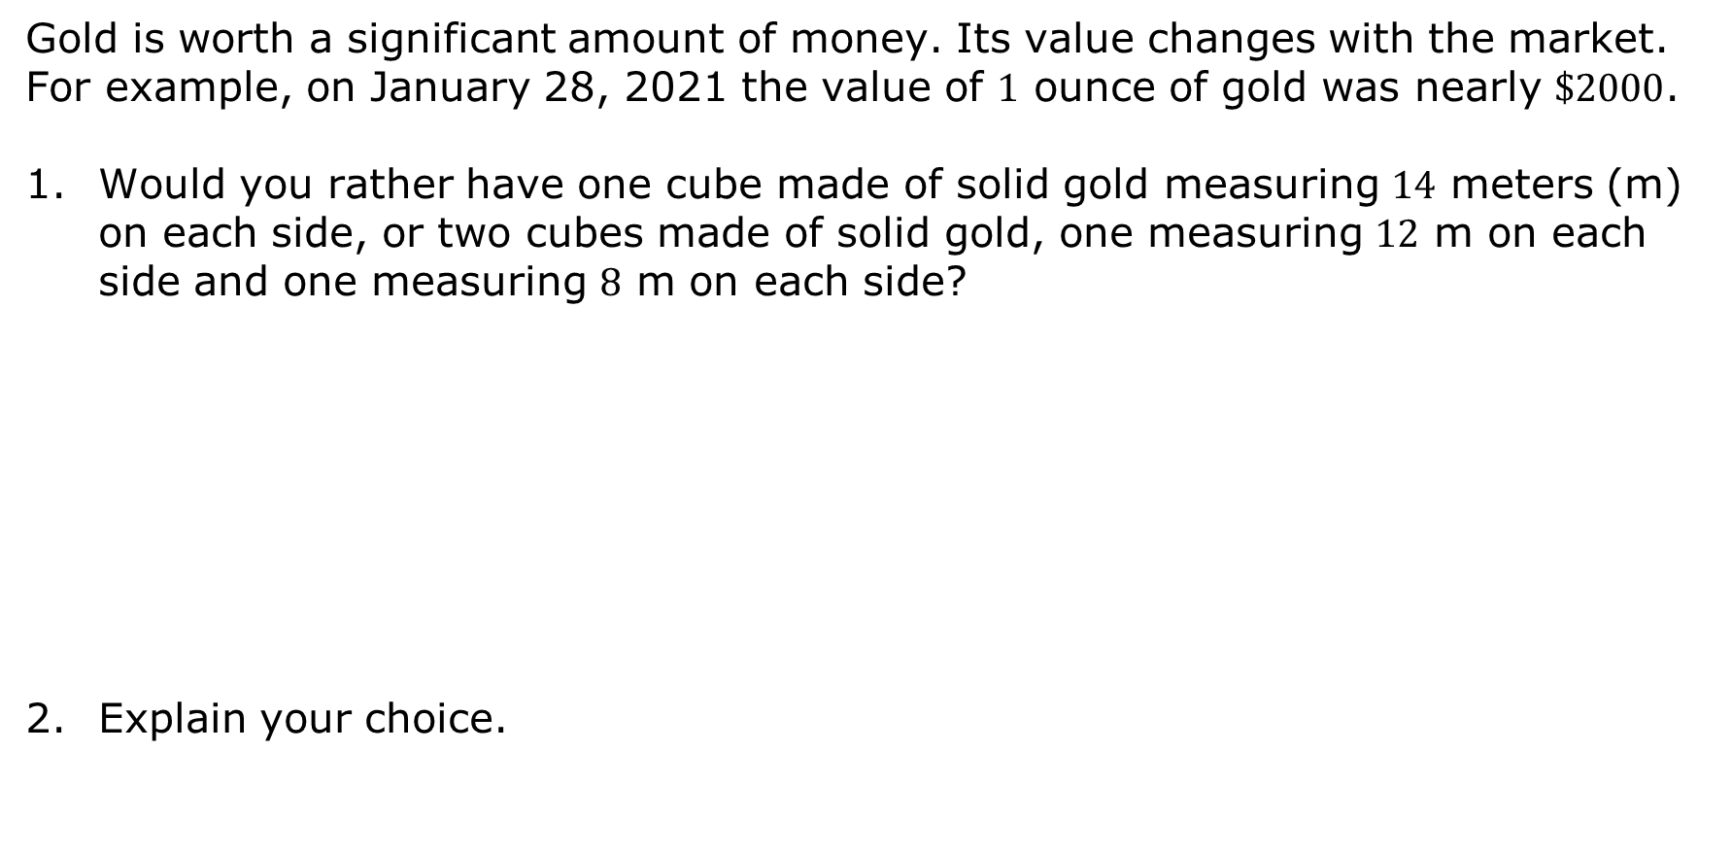
12.4.1 Warm-Up: Would You Rather?
Gold is worth a significant amount of money. Its value changes with the market. For example, on January 28, 2021 the value of $1$ ounce of gold was nearly $\$2000$.
Would you rather have one cube made of solid gold measuring $14$ meters (m) on each side, or two cubes made of solid gold, one measuring $12$ m on each side and one measuring $8$ m on each side?
Explain your choice.
volume 2, pg. 213

Slide 7

Activity
volume 2, pg. 213

Slide 8

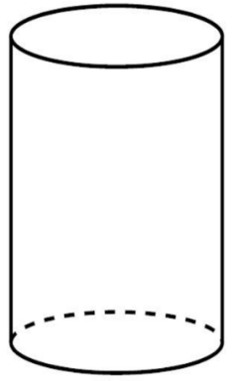
12.4.2 Activity: Penny Stacks – Volume of a Right Circular Cylinder
Stack the given pennies to form a right circular cylinder.
How many pennies high is the stack?
Compare your stack of pennies with your partner’s stack. Suppose both stacks are hollow such that liquid could be poured into them. Discuss with your
partner which stack would hold more liquid. Write a summary of your discussion.
volume 2, pg. 213

Slide 9

Capacity is the amount of space that can be filled in a container. Both capacity and volume are used to measure three-dimensional spaces.
Capacity usually refers to fluid measures, whereas volume is measured in cubic units.
Complete the statement.
The capacity, or volume, of the empty cylinder depends on
the radius of each coin.
the height of the coin stack.
both the height and radius of the coin stack.
volume 2, pg. 213

Slide 10
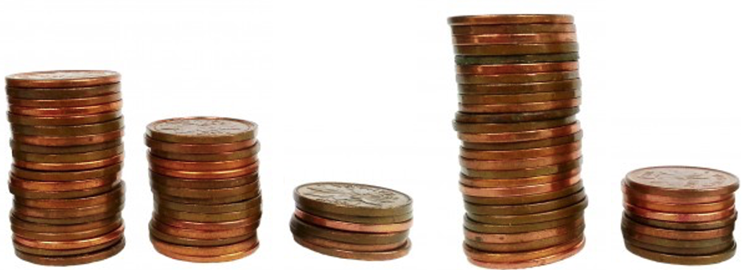
Circle the penny stack that has the greatest volume.
volume 2, pg. 214

Slide 11

Exploration
volume 2, pg. 214

Slide 12

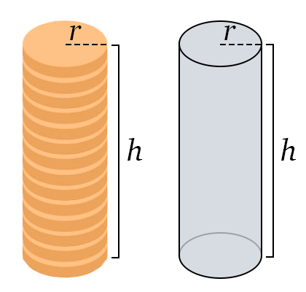
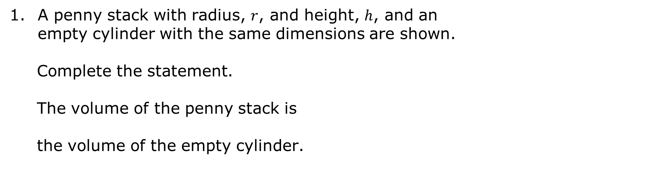
12.4.3 Exploration: Discovering the Volume of a Right Circular Cylinder
A penny stack with radius, $r$, and height, $h$, and an empty cylinder with the same dimensions are shown.
Complete the statement.
The volume of the penny stack is the volume of the empty cylinder.
equal to
not equal to
volume 2, pg. 214

Slide 13
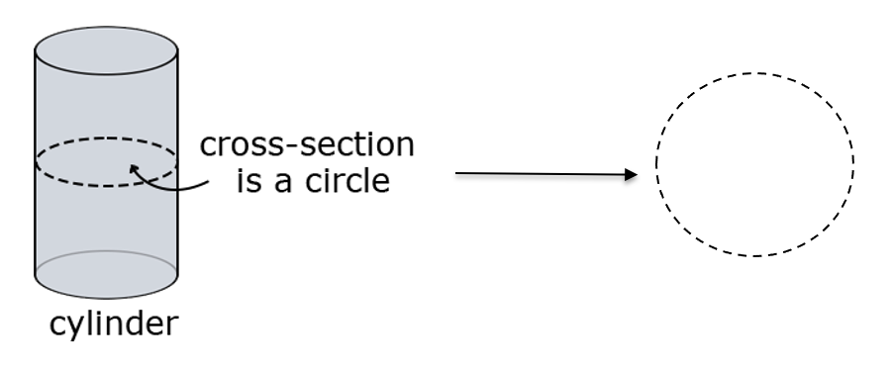
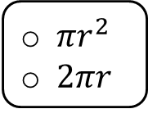
A cylinder can be sliced to create a cross section.
Complete the statements.
The cross section of the cylinder shown is the same size as the of the cylinder.
The expression represents the area of the cross section of the cylinder.
circular base
lateral area
height
$πr^{2}$
$2πr$
volume 2, pg. 215

Slide 14
With your partner, discuss the relationship between one of the cross sections of the cylinder and the capacity of the entire cylinder.
Summarize your discussion.
volume 2, pg. 215

Slide 15
Complete the statements.
Area measures the two-dimensional space an object takes up. The of the empty cylinder makes it a three-dimensional space, as multiple layers with the same area are stacked upon each other.
To find the volume of a cylinder, multiply the _________ of the base by the ___________ of the cylinder.
radius
height
volume 2, pg. 215

Slide 16
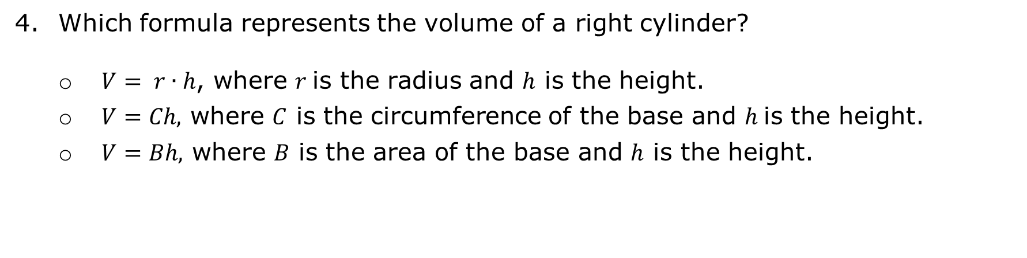
Which formula represents the volume of a right cylinder?
$V= r∙h$, where $r$is the radius and $h$ is the height.
$V=Ch,$ where $C$ is the circumference of the base and $h$ is the height.
$V=Bh,$ where $B$ is the area of the base and $h$ is the height.
volume 2, pg. 215

Slide 17

Guided Practice
volume 2, pg. 216

Slide 18

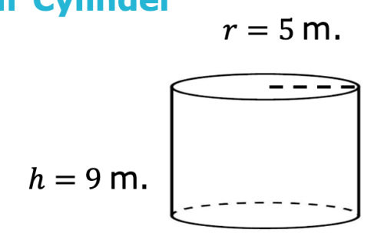
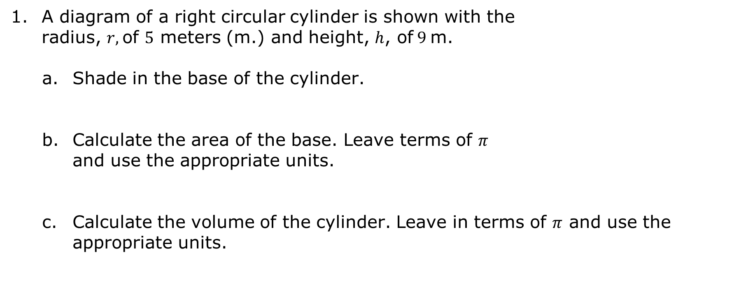
12.4.4 Guided Practice: Calculating the Volume of a Right Circular Cylinder
A diagram of a right circular cylinder is shown with the radius, $r,$of $5$ meters (m.) and height, $h$, of $9$ m.
Shade in the base of the cylinder.
Calculate the area of the base. Leave terms of $π$ and use the appropriate units.
Calculate the volume of the cylinder. Leave in terms of $π$ and use the appropriate units.
volume 2, pg. 216

Slide 19
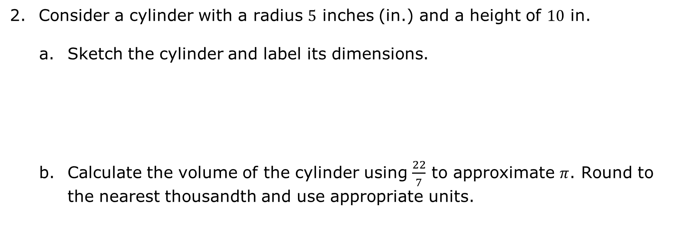
Consider a cylinder with a radius $5$ inches (in.) and a height of 10 in.
Sketch the cylinder and label its dimensions.
Calculate the volume of the cylinder using $\frac{22}{7}$ to approximate $π$. Round to the nearest thousandth and use appropriate units.
volume 2, pg. 216

Slide 20

Your Turn
volume 2, pg. 216

Slide 21
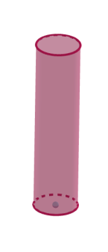
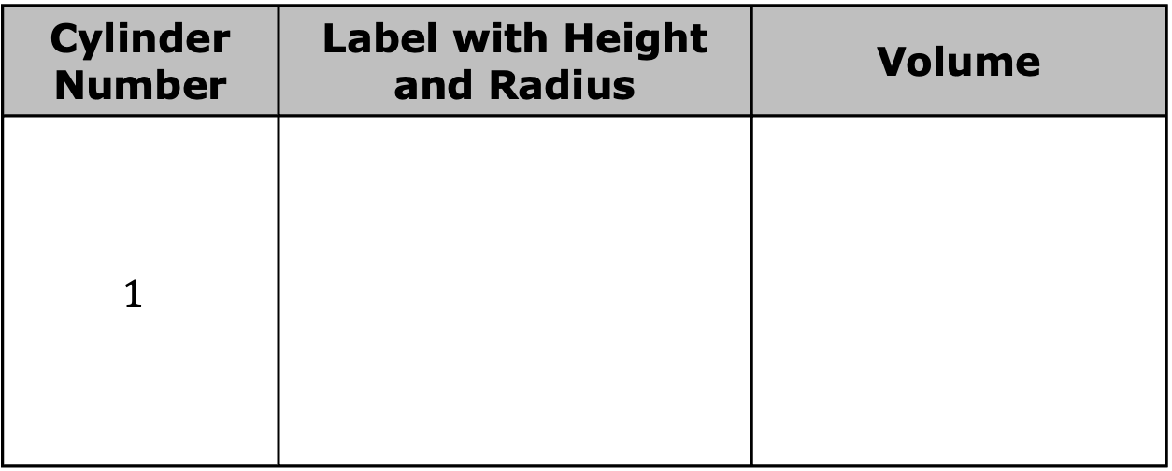
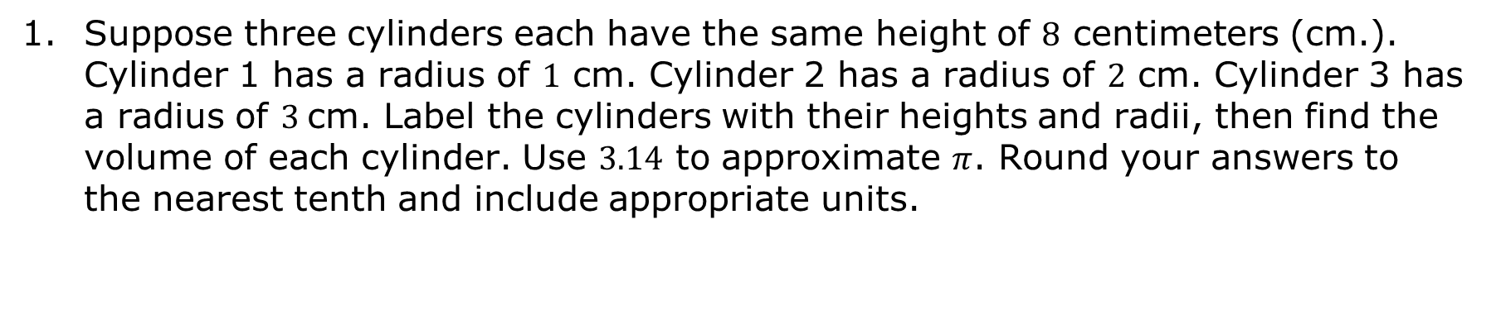
12.4.5 Your Turn!
Suppose three cylinders each have the same height of $8$ centimeters (cm.). Cylinder 1 has a radius of $1$ cm. Cylinder 2 has a radius of $2$ cm. Cylinder 3 has a radius of $3$cm. Label the cylinders with their heights and radii, then find the volume of each cylinder. Use $3.14$ to approximate $π$. Round your answers to the nearest tenth and include appropriate units.
Cylinder Number | Label with Height and Radius | Volume
$$1$$
volume 2, pg. 216

Slide 22
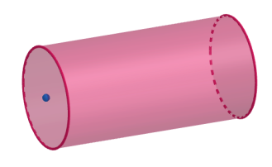
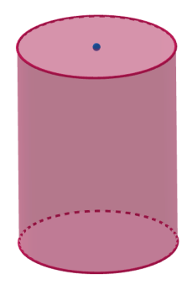
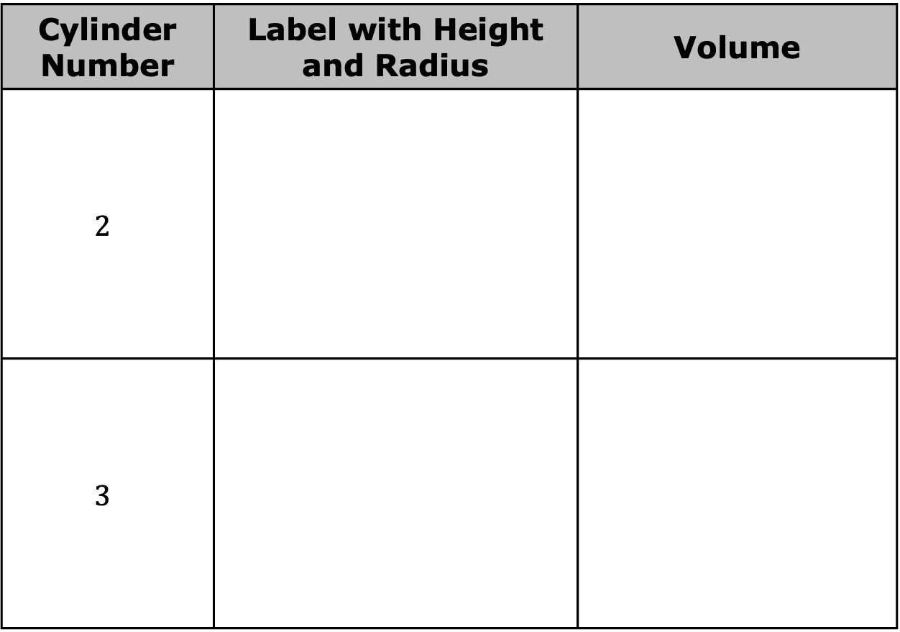
Cylinder Number | Label with Height and Radius | Volume
$$2$$
$$3$$
volume 2, pg. 216

Slide 23

Wrap-Up
volume 2, pg. 217

Slide 24
12.4.6 Wrap-Up: Reflection
Complete the table.
The terms and information used in the Exploration and Guided Practice that I knew were … | Something I wondered during the Exploration and Guided Practice was … | Something I learned during the Exploration and Guided Practice was …
volume 2, pg. 217

